Slide 1
Solar panel Regression
Title: Predicting Solar Panel Power Generation using Machine Learning

Slide 2
Objective:
To develop a predictive model that accurately estimates the power generated by solar panels.
To identify the key weather and environmental factors that influence solar panel power generation.
To utilize the model's predictions for optimizing solar panel performance and maximizing energy output.
To enable better planning and management of solar energy systems by providing accurate power generation forecasts.
To improve the overall efficiency and effectiveness of solar energy utilization.

Slide 3
EDA (Exploratory Data Analysis)
The EDA involved understanding the dataset's structure, exploring descriptive statistics, handling missing values, visualizing data distributions and relationships through various plots, and engineering a new feature by combining wind speed and average wind speed using PCA.

Slide 4
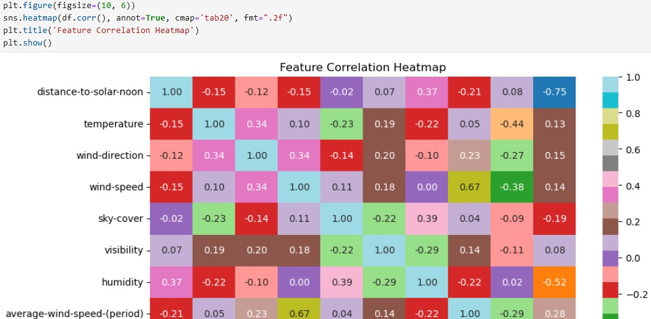
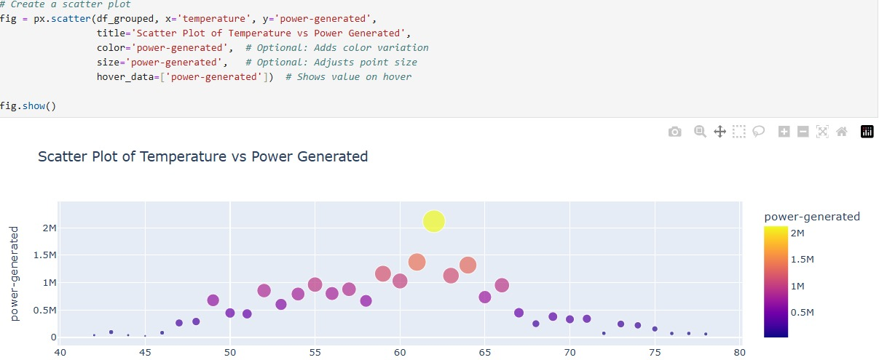
Visualization

Slide 5
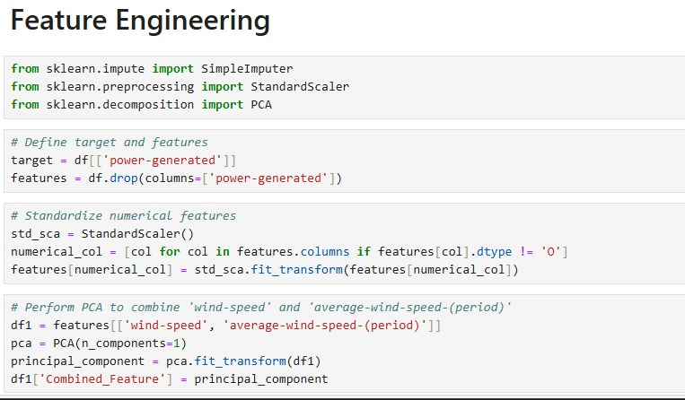
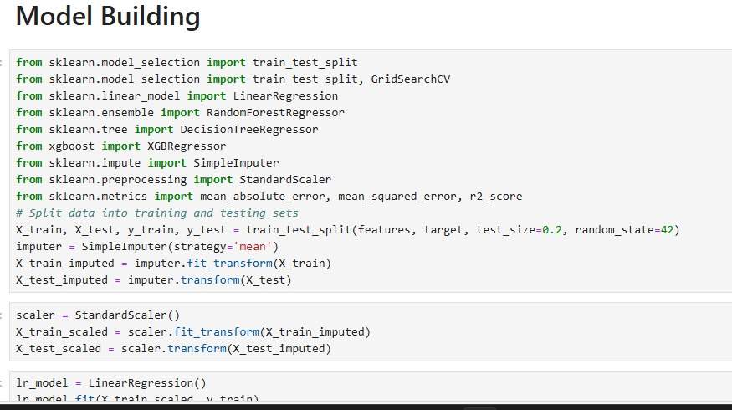

Slide 6
Model Building
Data Splitting: The data was split into training and testing sets (80% training, 20% testing).
Data Preprocessing: Imputation and scaling were applied to the data to handle missing values and ensure features are on a similar scale.
Model Selection: Various regression models were evaluated: Linear Regression, Random Forest, Decision Tree, and XGBoost.
Model Training and Evaluation: Models were trained on the training data and evaluated using metrics such as Mean Absolute Error (MAE), Mean Squared Error (MSE), Root Mean Squared Error (RMSE), and R-squared (R2).
Hyperparameter Tuning: XGBoost model was further improved using Grid Search to find optimal hyperparameters.
Model Saving: The best-performing model (XGBoost) and the data scaler were saved for future use.

Slide 7
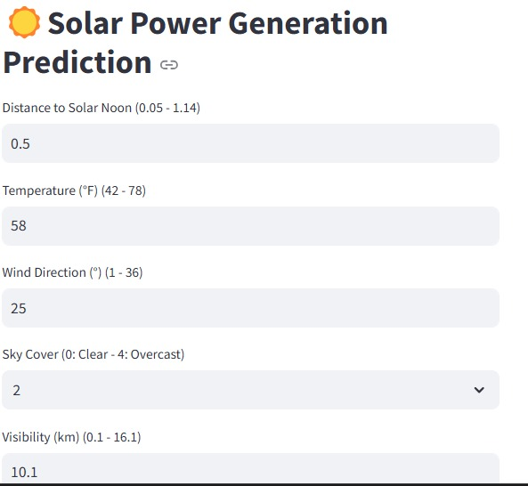
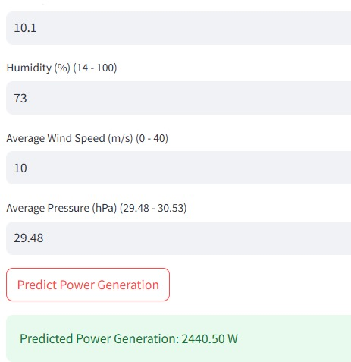
Deployment :Trained machine learning model accessible and usable for practical applications in real-world scenarios

Slide 8
Conclusion
Model Performance: XGBoost emerged as the best-performing model with the lowest RMSE and highest R-squared.
Insights: The EDA and model results revealed insights into the relationship between environmental factors (temperature, wind speed, etc.) and solar panel power generation.
Predictive Capability: The developed model can be used to predict power generation accurately, enabling better planning and management of solar energy systems.
Future Directions: Potential future improvements include exploring more advanced feature engineering techniques, experimenting with other models, and incorporating real-time data for more dynamic predictions.

Slide 9
Team members:
Priti Waghmare
Raman Muskawad
Akash Verma
Balu Srividya
Srikanth Lankemalla
Gopidesi Vamsi Krishna
Mentor name: Snehal Shinde
Co-mentor name: Stephy John

Slide 10
Thank you

